Slide 2
Distributed objects
The benefits of an object oriented approach to software development are greatly enhanced when they can be distributed over a network.
A classical object encapsulates code and data.
A distributed object is an object that can live anywhere on a network, and can be invoked by remote clients via method invocations.

Slide 3
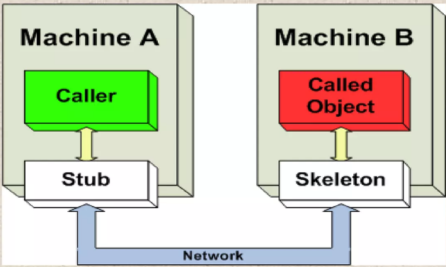
Distributed objects
Distributed objects refers to software modules that are designed to work together, but reside either in multiple computers connected via a network or in different processes inside the same computer.

Slide 4
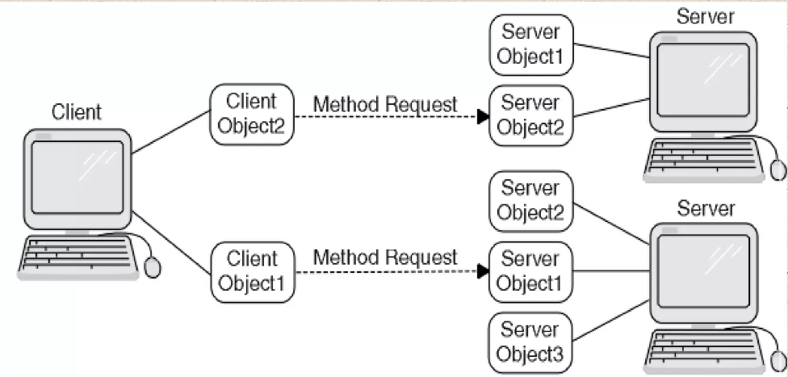
Working of Distributed objects

Slide 5
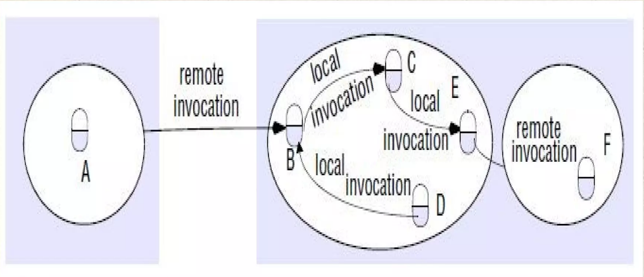
Remote Invocation

Slide 6
Why Components?
Interoperability between:
Different Languages
Different Compilers
Different Vendors
Different Operating Systems
Different Tools
Different Networks
Different Applications
Different Address Spaces

Slide 7
Properties of Components
A marketable entity
Not a complete application
Usable in unpredictable combinations
Well specified interface
Toolability
Event notification
Configuration and property management
Scripting
Metadata and Inspection
Interoperability
Ease of Use

Slide 8
Server Side Components
Components on the Server side need added intelligence.
They need to be more concerned with:
Security,
Licensing,
Versioning,
Life Cycle Management,
Transaction Control and Locking,
Persistence,
Relationships,
Self-Testing,
Semantic Messaging and
Self-installation than Client side components.

Slide 9
Server Security Issues
Distributed Objects create special security problems for Servers:
They can play both Client and Server roles
Distributed objects evolve constantly
Their interactions are not well understood
Distributed objects are less predictable
Distributed objects are polymorphic
Distributed objects can scale without limit
Distributed objects are very dynamic
Most of these problems can be solved by moving security into the CORBA ORB.

Slide 10
Distributed Object Technology
DCOM
DCOM is used for single platform, multiple languages.
JINI
Enterprise Java Beans
COM+
Object Oriented Databasess
CORBA
CORBA is used for single platform, multiple languages.

Slide 11
Component Standards
On the desktop, Java Beans and ActiveX are competing component standards.
On the server, component standards include Enterprise Java Beans, CORBA Beans, and COM+.
CORBA Internet Inter-ORB Protocol (IIOP) provides a transactional pipe for EJBs, linking Java and CORBA.

Slide 12
Distributed Object Topics
Object Brokers
Object Services
Object Transaction Monitors
Object Groupware
Object Databases
Object Web Technology
Object Linking
Object Frameworks

Slide 13
Object Request Broker (ORB)
An Object Request Broker (ORB) provides the connections that allow components to interoperate.
An ORB must be augmented with a high- level component infrastructure that defines how the objects can work together.
This component infrastructure defines how object operate within containers (or frameworks).

Slide 14
Object Transaction Monitors
OTMs are the state of the art in component management.
Instead of the ORB approach, where you need to write separate code to call each needed service separately, an OTM provides a suite of services with a common call structure.

Slide 16
Benefits of Distributed Objects
Visual tools and other applications can discover an object's interfaces, events, and properties dynamically.
Granular components can be visually assembled with tools, interoperate across networks, run on different platforms, and manage themselves and their resources.
Object Oriented client server applications can be more flexible than traditional approaches.
Components can be mixed and matched without sacrificing robustness.
Interfaces are separated from implementations, so you can use an object wrapper to make an existing legacy application look like an object.

Slide 17
Defining Standard
The Object Management Group and Microsoft Corporation are the key competitors that are driving the movement toward distributed objects.
OMG is the force behind CORBA and its integration with Java.
Microsoft is trying to establish its own proprietary standard based on DCOM, ActiveX, COM+ and .NET

Slide 18
CORBA
(COMMON OBJECT REQUEST BROKER ARCHITECTURER)

Slide 19
What is CORBA
CORBA is a distributed object-based systems.
Provides inter-operability
CORBA is a middle ware neither 2-tier or 3-tier architecture.
CORBA is a technology to communicate 2 objects which are of heterogeneous type.
CORBA can be written in c, c++, COBOL and JAVA

Slide 20
CORBA was created by OMG (Object management group).
OMG was created in 1989.
OMG does not provide any s/w products.
The first version of CORBA was released in July, 1992 as “ОВЈЕСТ МANAGEMENT ARCITECTURE GUIDE" Concept of CORBA came from OLE.

Slide 21
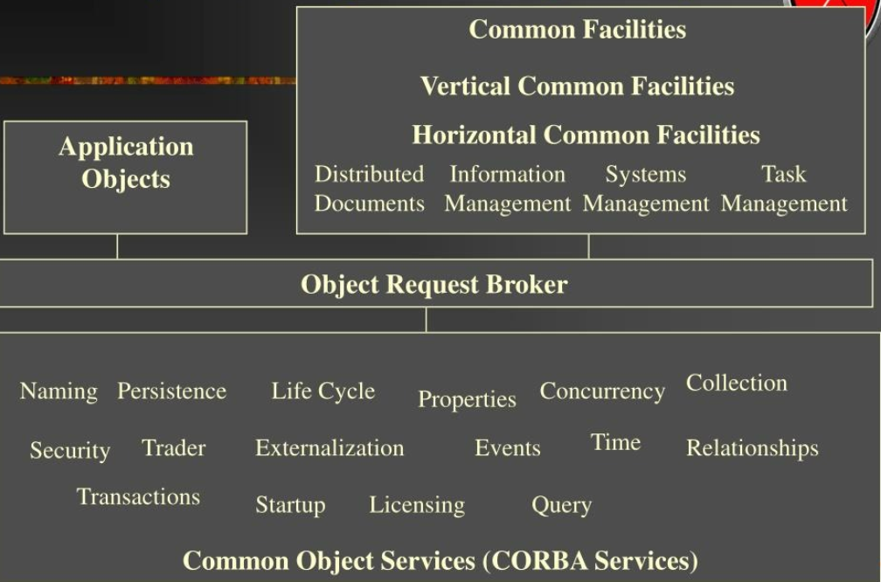
Object Management design (OMA)

Slide 22
Object Request Broker (ORB)
ORB is the object bus.
ORB is the middleware that establishes the client/server relationship between objects.
ORB lets objects communicate transparently without concern for :
the hosts where the objects run
the operating systems
the programming languages

Slide 23
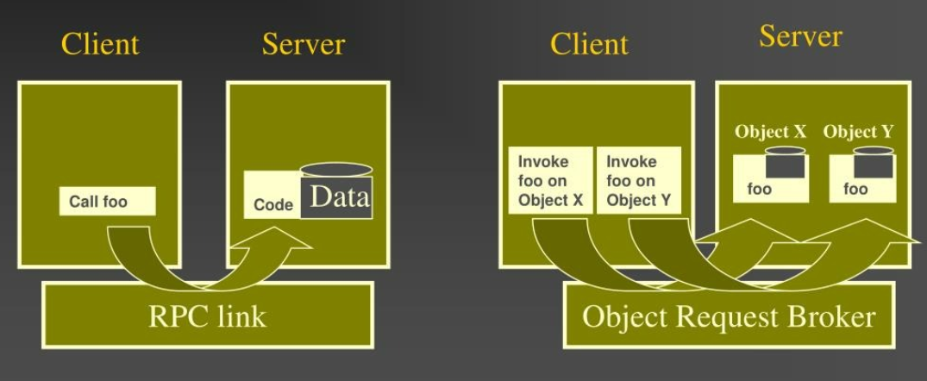
RPC vs ORB

Slide 24
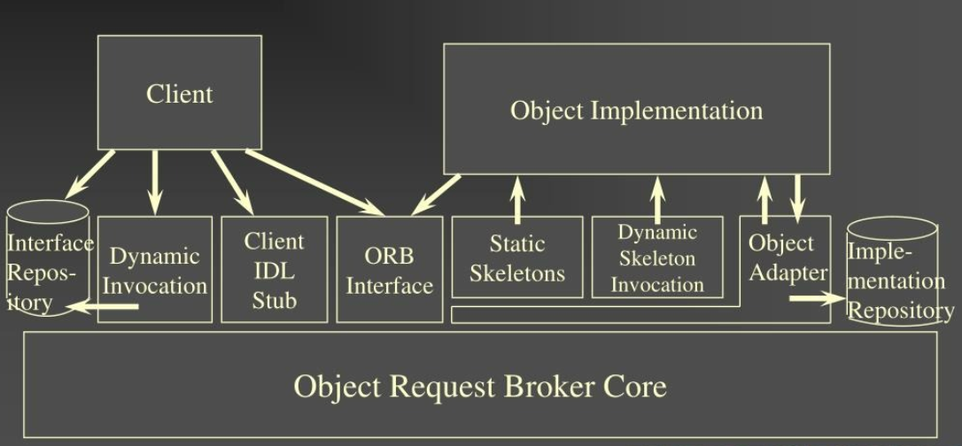
Structure of CORBA 2.0 ORB

Slide 25
CORBA Services
Clock service maintains synchronized time
Authentication service validates user id's
Object storage service: a file system for objects
Life cycle service: oversees activation, deactivation, storage, check pointing, etc.
Transactions and replication services
Naming services
Security services

Slide 26
CORBA Advantage
Interaction with legacy systems.
Static and dynamic method invocations
High-level language bindings
Location transparency
Built-in security and transactions

Slide 27
CORBA Problem
Design and process deficiencies.
Problems with Firewalls.
Problems with implementation.

Slide 28
RMI vs CORBA
Language Barrier.
RMI can be easier to master than corba.corba is rich and extensive family of std and interfaces.
Corba is peer-to-peer orb communication model and Rmi is server centric model.
RMI interface is defined in RMI-IIOP and corba interfaces are defined in IDL.

